Slide 1
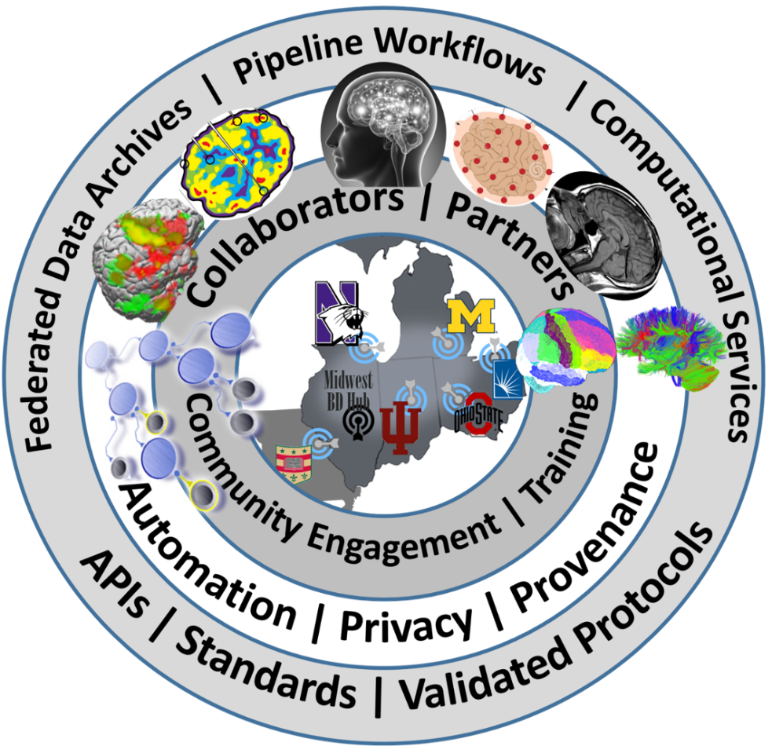

Midwest Workshop on Big Neuroscience Data, Tools, Protocols & Services
Computational Neuroscience Network (ACNN)
http://www.NeuroscienceNetwork.org/ACNN_Workshop_2016.html

Slide 2


Workshop Overview
Ivo D Dinov
Statistics Online Computational Resource (SOCR)
Michigan Institute for Data Science (MIDAS)
University of Michigan
http://www.umich.edu/~dinov

Slide 3
Logistics
WiFi: MGuest
What | An interactive Big Neuroscience Data Analytic Workshop
Where/Venue | Michigan League, University of Michigan, 911 N University Ave, Ann Arbor, MI 48109, Phone: (734) 764-0446, Web: https://uunions.umich.edu/league
Dates | September 20-21, 2016
Accommodation | Michigan League, University of Michigan, 911 N University Ave, Ann Arbor, MI 48109, Phone: (734) 764-0446, Web: https://uunions.umich.edu/league The Holiday Inn Near the University of Michigan, 3600 Plymouth Road, Ann Arbor, MI 48105, 734-796-9800, Web: http://www.hiannarbor.com
Travel Scholarships | 60 Travel scholarships are available for Students, Postdocs, Fellows, and other Trainee on a first-come-first-serve bases
URL | www.NeuroscienceNetwork.org/ACNN_Workshop_2016.html

Slide 4
Program
Time | Day 1 (Tue 9/20/16)
 | Sessions | Details
8-9 AM | Registration | Onsite registration, nametags, booklets, breakfast, coffee, networking
9:00-9:45 | Workshop Overview ACNN Background, Scope Organization/Format | Workshop Overview (Ivo Dinov), 15 min Midwest Big Data Hub Health Sciences (Brian Athey), 15 min Advanced Computational Neuroscience Network (Rich Gonzalez), 15-min
9:45-12:15 | Big Neuroscience Data, Gaps/Barriers, Analytical Methods, Available Resources, Distributed Services, and Opportunities | Indiana Computational Neuroimaging Research (Franco Pestilli) 20 min OSU Network Based Computing (DK Panda, K Hamidouche, X Lu, H Subramoni) 20 min CWRU Biomedical and Healthcare Informatics (Satya Sahoo) 20 min BREAK 10 min (4) HumanConnectome: Neuroimaging Informatics and Analysis Center (Daniel Marcus) 20 min (5) Northwestern Neuroimaging and Applied Computational Anatomy (Lei Wang) 20 min (6) Michigan Institute for Data Science (Ivo Dinov), 20 min
12:15-1:15 | Lunch Break
1:15-3:15 | Unconference Breakouts | Informal self-organized sessions (30-minutes each), round-robin rotations. (4 consecutive slots of 30-min each). Participants lead breakouts and mix with others
3:15-3:30 | Break
3:30-4:30 | Breakout sessions reports | Analytics Pipelines Tools/Services; Challenges; Known Solutions; Predictive analytics - methods, tools, protocols, workflows Provenance (data, protocols, results, reproducibility or research findings); Computational Neuroscience Methods; Case-studies, data archives, Cloud Services
4:30-5:30 | Posters/Demos | Applications (brain mapping, imaging-genetics, neurodegeneration)
6:00-8:00 PM | Dinner | Social Networking

Slide 5
Program
Time | Day 2 (Wed 9/21/16)
 | Sessions | Details
8:00-8:30 AM | Registration | Onsite registration, nametags, booklets, breakfast, coffee, networking
8:30-11:00 | Core Big Neuroscience Infrastructure | Neuroscience Information Framework (NIF): A Cooperative And Collaborative Information, Resource, and Data Discovery Infrastructure (Jeff Grethe) 25 min Indiana Computational Neuroimaging Research (Franco Pestilli) 25 min OSU Network Based Computing (DK Panda, K Hamidouche, X Lu, H Subramoni) 25 min BREAK 10-min (4) CWRU Biomedical and Healthcare Informatics (Satya Sahoo) 25 min (5) Graphical Pipeline Workflows for Integrated Neuroscience (Ivo Dinov), 25 min
11:00-11:10 | Break
11:10-12:10 | Lightning Talks | 3-5 min Rapid-Fire talks from the Midwest Big Data Community
12:10-1:10 | Lunch Break
1:10-2:40 | Unconference Breakouts | Informal self-organized sessions (3 x 30-minutes each), round-robin rotations: Brain structure, Function, Diffusion, Physiology; File Formats; Pipeline workflow Environments; Cloud Services: JIRA, GitHub, Trello, AWS, MapReduce, Hadoop; Driving Biomedical/Healthcare Challenges, etc.
2:40-2:50 | Break
2:50-3:30 | Breakout sessions reports | Analytics Pipelines Tools/Services; Challenges; Known Solutions; Predictive analytics - methods, tools, protocols, workflows; Provenance (data, protocols, results, reproducibility or research findings); Computational Neuroscience Methods; Case-studies, data archives, Cloud Services
3:30-4:00 | Live Demos / Try-It-Now | Applications (brain mapping, imaging-genetics neurodegeneration)
4:00 PM | Conclusions | Workshop Evaluation (http://www.neurosciencenetwork.org/ACNN_Workshop_2016.html). Collaborations, joint papers, extramural grant opportunities, Shareable resources, Available Webapps, APIs, workflows

Slide 6
Handbook

Slide 7
Organizers
The Advanced Computational Neuroscience Network (ACNN)
University of Michigan: Ivo Dinov, Rich Gonzales, George Alter
Indiana University: Franco Pestilli, Olaf Sporns, Andrew Saykin
OSU: DK Panda, Khaled Hamidouche, Xiaoyi Lu, Hari Subramoni
CWRU: Satya Sahoo
Washington University: Daniel Marcus
Northwestern University: Lei Wang

Slide 8
Workshop Goals
Actively engage students, trainees, fellows, junior investigators, and outside researchers in Midwest academic institutions and industry partners
Build an active Midwest Neuroscience Network Community
Openly share data-intense challenges, datasets, research projects, expertise, software, services, protocols, resources, learning modules
Discuss joint (multi-institutional) grants, training opportunities, publications, research projects

Slide 9
Unconference Breakout Sessions
Use the Breakout Session Board/Online-Form to review and propose discussion topics at the appropriate times. Be prepared to take notes at your break out session and report on outcomes, achievements, plans, and actions that came out of the discussions
Unconference Breakout Sessions (consecutive slots of 30-min each). Participants are encouraged to form WGs, lead breakouts, and mix with others. These are Informal self-organized sessions. Participants can rotated through breakouts
https://goo.gl/bKWNvi

Slide 10
Unconference Breakout Sessions
Day 1: 1:00-3:00 PM |  |  |  |  |  | Day 2: 1:00-2:30
Proposed Topics | 1-1:30 | 1:30-2 | 2:2:30 | 2:30-3 |  | Proposed Topics | 1-1:30 | 1:30-2 | 2:2:30
Enter Topic1 | (tally interested attendees) | … | … | … |  | Enter Topic1 | (tally interested attendees) | … | …
… | ... | … | … | … |  | … | ... | … | …
Breakout Session Reports: 3:20-4:20 Analytics Pipelines Tools/Services Challenges Known Solutions Predictive analytics - methods, tools, protocols, workflows Provenance (data, protocols, results, reproducibility or research findings) Computational Neuroscience Methods Case-studies, data archives Cloud Services Other |  |  |  |  |  | Breakout Session Reports: 2:30-3:00 Analytics Pipelines Tools/Services Challenges Known Solutions Predictive analytics - methods, tools, protocols, workflows Provenance (data, protocols, results, reproducibility or research findings) Computational Neuroscience Methods Case-studies, data archives Cloud Services Other
https://goo.gl/bKWNvi

Slide 11
Hands-on & Try-It-Now Demos
Sign in to present and showcase hands-on their group’s challenges, case-studies, datasets, software tools, services, computational infrastructure, and other materials and resources. Avoid sales pitches and infomercials. Open-science resources should be emphasized
Draft a 1-page PDF handout and email to aalison@med.umich.edu
See the Shareable Resources section
Day 2: 3:00-4:00
Demos | 3:00-3:20 | 3:20-3:40 | 3:40-4:00
Demo 1 Description | (tally interested attendees) | … | …
… | ... | … | …
https://goo.gl/bKWNvi

Slide 12
Shareable Resources
Use the web-form to submit items for inclusion in the sharable resources
Examples (not an exclusive list) of appropriate resources include:
Highly scalable APIs
Relevant publications
Cloud-services
Computational Resources
Algorithms, methods, techniques
Education and Training Opportunities
https://goo.gl/gpTrRg

Slide 13

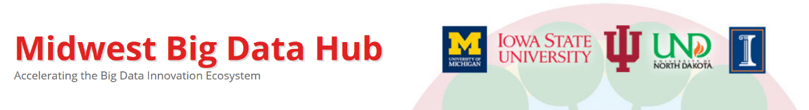






Workshop Sponsors
The National Science Foundation
http://www.nsf.gov
Midwest Big Data Hub
http://MidwestBigDataHub.org
OSU Network Based Computing
http://nowlab.cse.ohio-state.edu
 | High-performance Big Data (HiBD) Network-Based Computing Laboratory
The Michigan Institute for Data Science (MIDAS)
http://midas.umich.edu
The Indiana Imaging Research Facility (IRF)
https://www.indiana.edu/~irf/home
Imaging Research Facility
Indiana University Bloomington
CWRU Biomedical and Healthcare Informatics
https://goo.gl/l19s07
Michigan Nutrition Obesity Research Center
(MNORC) http://mmoc.med.umich.edu

Slide 14
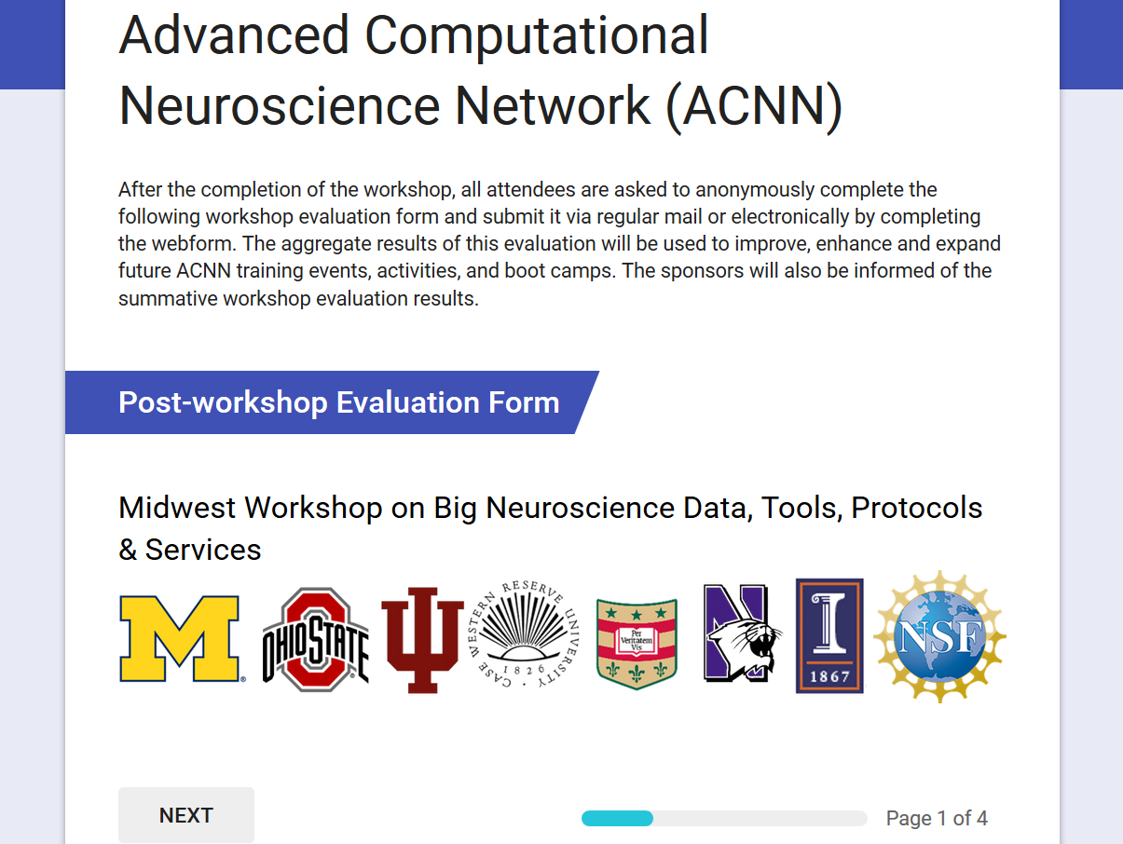
Post-conference Evaluation
After the completion of the workshop, all attendees are asked to anonymously complete the web-based workshop evaluation form. The aggregate results of this evaluation will be used to improve, enhance and expand future ACNN training events, activities and bootcamps. The sponsors will also be informed of the summative workshop evaluation results
http://goo.gl/forms/qSI6PGiN4PfTs6Fg1

Slide 15
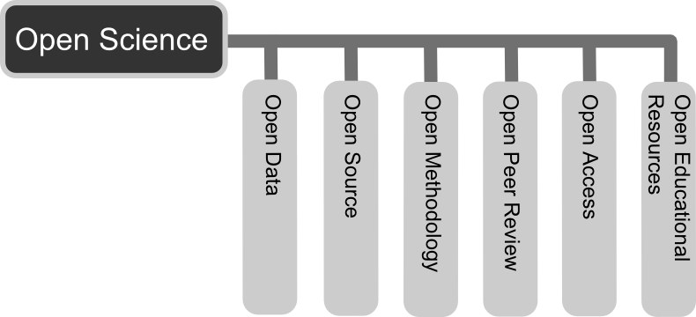
Open-Science Principles
Share resources
Collaborate
Permissive licenses (e.g., LGPL/CC-BY)
Project management (e.g., GitHub/Jira)
Open-access pubs
Public-private partnerships
Co-mentoring of trainees
Effective transdisciplinary methods
Resource Interoperability
Result Reproducibility

Slide 17
Workshop Sponsors
The National Science Foundation
http://www.nsf.gov
Midwest Big Data Hub
http://MidwestBigDataHub.org
OSU Network Based Computing
http://nowlab.cse.ohio-state.edu
 | High-performance Big Data (HiBD) Network-Based Computing Laboratory
The Michigan Institute for Data Science (MIDAS)
http://midas.umich.edu
The Indiana Imaging Research Facility (IRF)
https://www.indiana.edu/~irf/home
Imaging Research Facility
Indiana University Bloomington
CWRU Biomedical and Healthcare Informatics
https://goo.gl/l19s07
Michigan Nutrition Obesity Research Center
(MNORC) http://mmoc.med.umich.edu

